Slide 1
What is cloud computing?
Cloud computing is something that
An approach to computing that’s about having the right resources at the right time, and connecting to a variety of devices and endpoints.
Notes:
The computing that is done in the cloud i.e. over internet.

Slide 2
“
Its all about Services!
Not just about servers
”
”

Slide 3
Cloud computing?
Delivering computing services like servers, storage databases, networking, software, analytics and more over internet.
Types of cloud computing
A. Infrastructure as a Service
B. Platform as a Service
C. Software as a Service

Slide 4
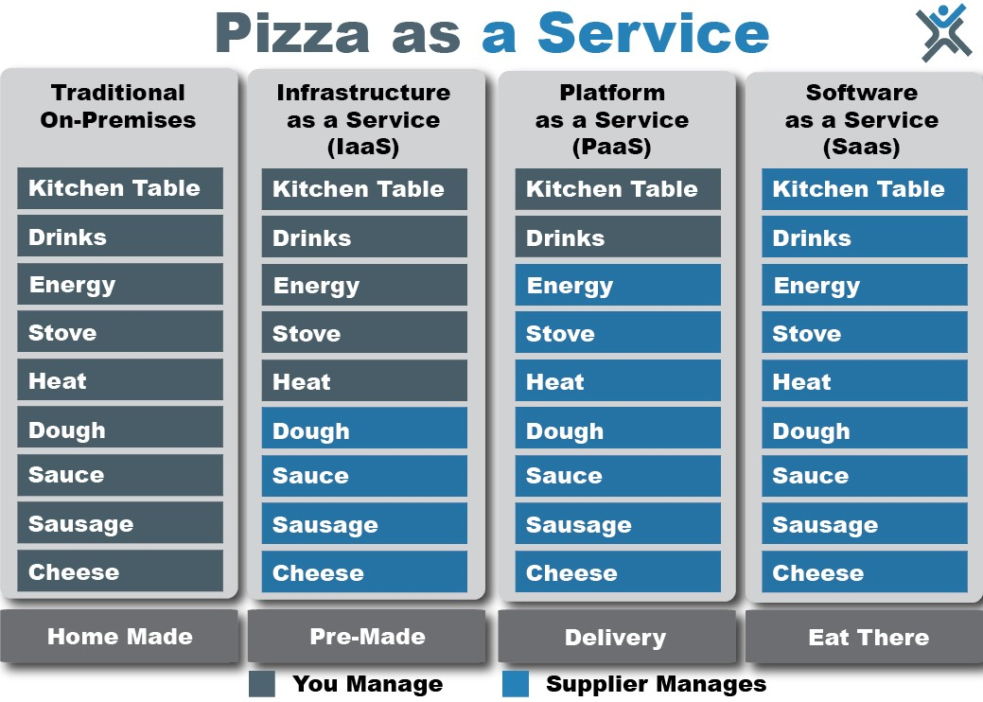

Slide 5
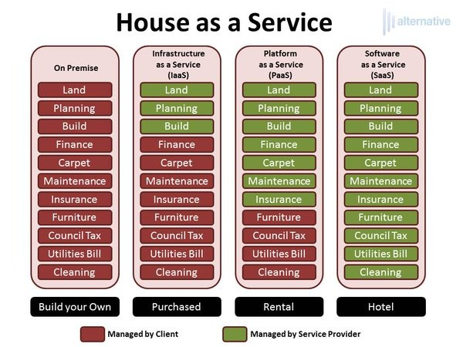

Slide 6
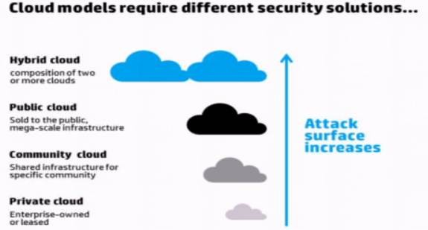

Slide 7
Cloud Deployment models characteristics
Private Cloud:
Supports all users from within company itself
Managed by the organization itself
More expensive than public clouds due to the capital expenditure
Able to address the security and privacy concerns of organizations today
Public Cloud:
Supports all users who want to make use of a computing resource
Subscription is required for signup
Pay as you go model
Increase capacity as and when needed
Community cloud:
Supports multiple organizations sharing computing resources that are part of a community
Access to a community cloud environment is typically restricted to the members of the community
Hybrid cloud:
An organization makes use of interconnected private and public cloud infrastructure

Slide 8
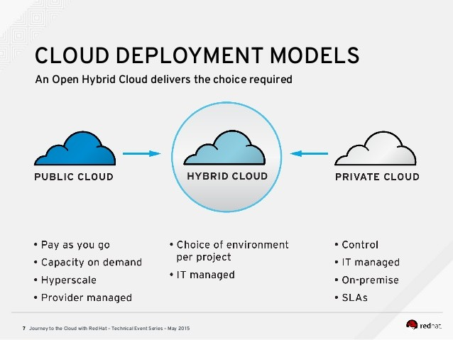

Slide 9
SaaS (Software as a service)
Software as a service applications are designed for end users, delivered over internet.
• Web access to commercial software • Software is managed from a central location • Software delivered in a “one to many” model • Users not required to handle software upgrades and patches
Examples of SaaS: Office 365, ServiceNow, SalesForce

Slide 10
PAAS (PLATFORM AS A SERVICE)
Set of tools and services designed to make coding and deploying those applications quick and efficient.
Everything (Patching, security of instance, etc.) is maintained by service provider. You only deploy code and run your application in the cloud.
• Web based user interface creation tools help to create, modify, test and deploy different UI scenarios • Multi-tenant architecture where multiple concurrent users utilize the same development application • Built in scalability of deployed software including load balancing and failover • Integration with web services and databases via common standards
Example: Web service in Azure, ElasticBeansTalk in AWS

Slide 11
IAAS (Infrastructure as a service)
IaaS is hardware and software that powers it all – servers, storage, networks, operating systems. Everything is provided by service provider and maintaining the infrastructure including patching, security patches is customer responsibility.
Resources are distributed as a service • Allows for dynamic scaling • Has a variable cost, utility pricing model • Generally includes multiple users on a single piece of hardware

Slide 12
Benefits of cloud computing
Trade Capital Expense for Variable Expense
Traditional on premise datacenters require upfront heavy capital investment
With cloud, you pay only when you consume resources and pay only for how much you consume
Benefit from massive economies of scale
Shared Infrastructure used by hundreds of thousands of customers
Lower pay-as-you-go prices
Lower variable cost with cloud computing than traditional on-premise data centers
Stop guessing about capacity
Eliminate guessing on your infrastructure capacity needs
Capacity decision prior to deploying an application often results in over capacity with idle resources or under capacity with constrained resources
With Cloud, you can scale up or down with only a few minutes notice

Slide 13
Benefits of cloud computing
Increase Speed and Agility
In cloud, new resources and just a click away
Developers can get resources in minutes instead of waiting for weeks
Cost to experiment and develop is significantly lower
Hourly pricing model - try new products at very low cost
Stop spending money running and maintaining data centers
Avoid undifferentiated heavy lifting
Focus on projects that differentiate your business, not infrastructure
Go Global in minutes
Easily deploy multiple applications in multiple regions around the world
Keep resources near the customer for lower latency and compliance requirements
Better end user experience at minimal cost

